Slide 1
Introduction to Android Studio
Università di Modena e Reggio Emilia
Prof. Nicola Bicocchi (nicola.bicocchi@unimore.it)

Slide 2
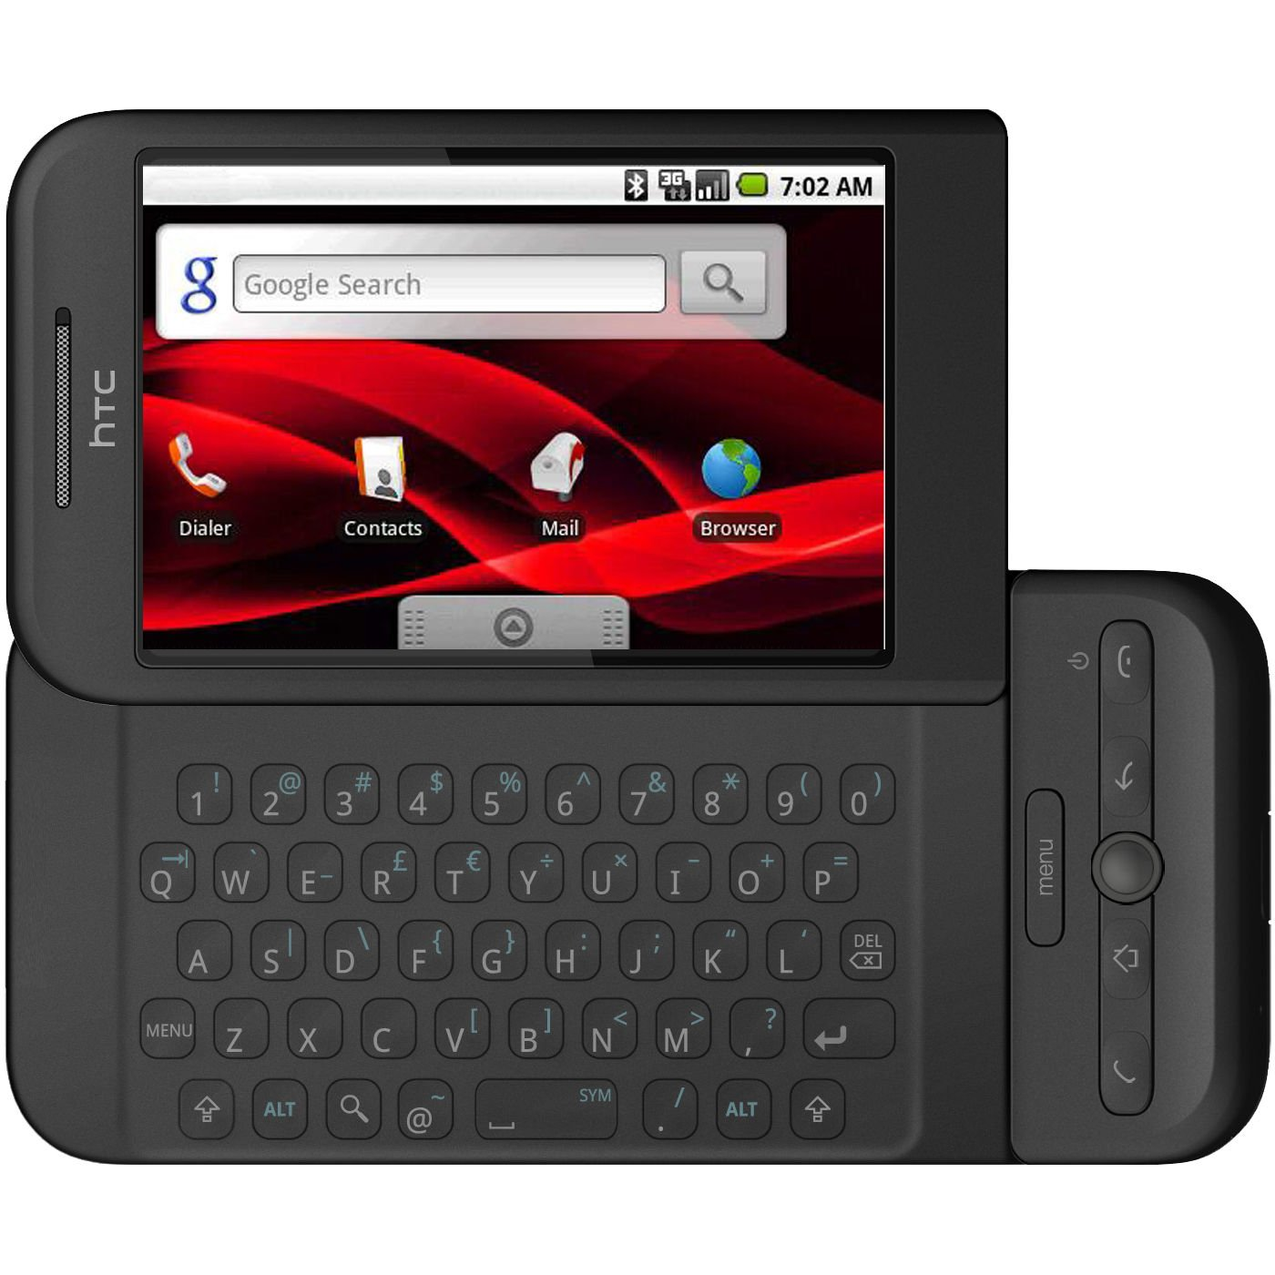
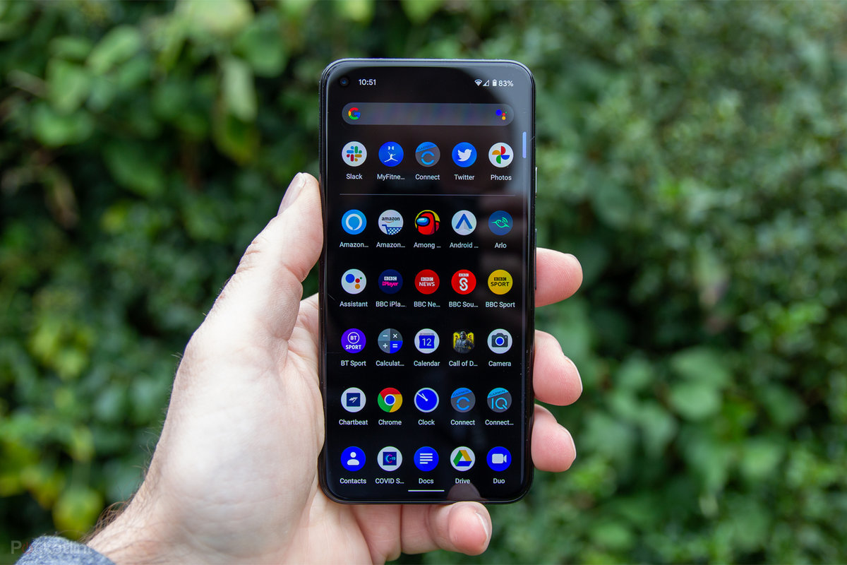
Why Android?
The use of smartphones has had an exponential spread, if we think before the cost of these was very high and with few features, today you can buy smartphones at a low cost and with many features. There are many types of operating systems, but we will focus on one of them: Android

Slide 3
Why Android?
Android is an open-source system:
you have free access to all the tools used by the same Android vendors, the apps that you can develop from third parties has no limitations
anyone can develop for Android without having to acquire special software or licenses
Also:
makes it possible to find, modify and redistribute the source code by adapting it to each device
native or third-party applications are of equal importance, can be removed without any limitation
Is widespread, we have the confidence that our application can be supported on many devices without having to worry about us
has high quality graphics and audio management

Slide 4
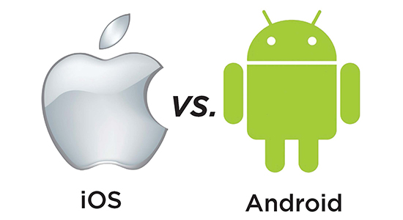
Last but not Least
If you choose Android and you want share your app on Play Store you must pay a cost of subscription, that’s it! you can code with any operating system like Windows, OS X and Linux.
Instead programming for iOS involves spend a cost of subscription on Apple store 4 times higher, plus you need to pay software for coding and do it only with Mac computers.

Slide 5

History
Android began in 2003 as a project of the American technology company Android Inc., to develop an operating system for digital cameras.
In 2004 the project changed to become a smartphone operating system. Andy Rubin, Rich Miner, and Chris White
founded Android Inc. for the development of what Rubin called «... mobile devices more aware of the location ……and preferences of their owner» . It was purchased by the American search engine company Google Inc.,
in 2005. At Google, the Android team decided to base their project on Linux, an open-source operating system for personal computers

Slide 6
History
In September 23,2008 Android 1.0 was released, the first commercial version of the software. The first commercially available Android device was the HTC Dream. Android 1.0 incorporated the following features:
Android Market, enabling app downloads and updates via the Market app.
Web browser to show, enlarge and browse complete HTML and XHTML web pages - multiple pages displayed as windows ("tabs"). Camera support - however, this version did not have the ability to change the camera resolution, white balance, quality, etc.
Folders that allow grouping a number of application icons into a single folder icon on the home screen.
Access web email servers, which support POP3, IMAP4, and SMTP. Sync Gmail with Gmail app.
Sync Google contacts with the People app.
Synchronization of Google Calendar with the Calendar application.
Google Maps with Street View to view maps and satellite images, as well as find local businesses and get directions using GPS.

Slide 7
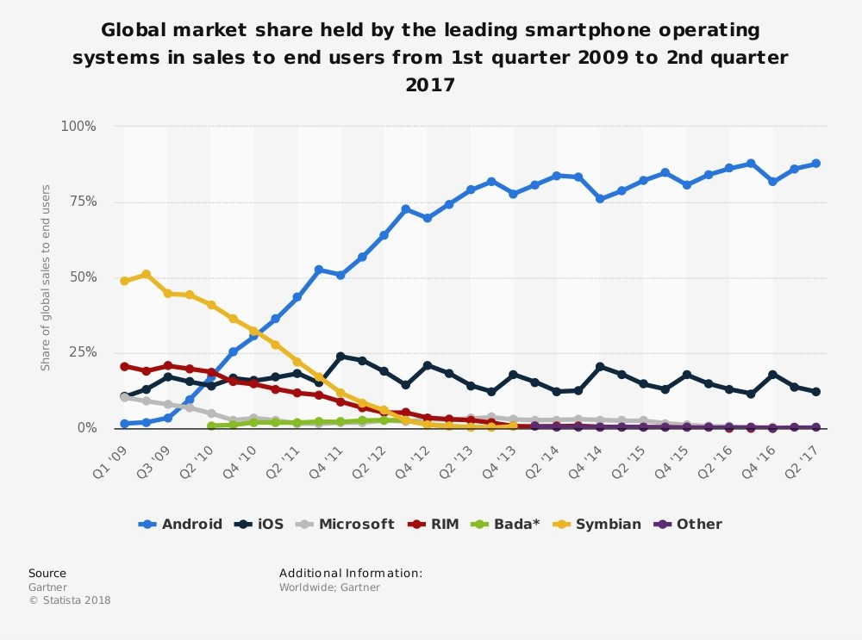
Today
After Android 1.0 multiple versions were released see: Android’s versions
Currently the preview of Android 13 is out.
Nowadays android is the main operating system for embedded system (telephone and tablet) .
Is the operating system on which 2.5 billion active devices are based

Slide 8
Focusing on Android

Slide 9
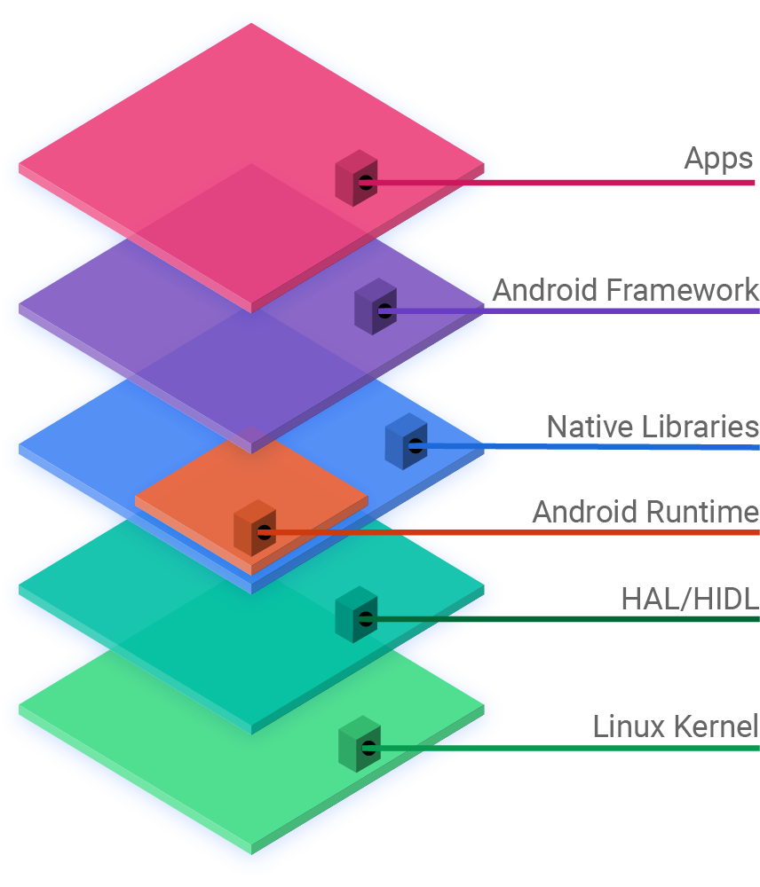
Android Architecture
Android OS is based on kernel Linux, is structured by layer/levels each of them give at higher level an abstraction of underground system.
There are 6 principal layer:
Apps: is the top layer, the pre-installed applications like home, contacts, camera, gallery etc. and third parts applications downloaded from the play store like chat applications, games etc. will be installed on this layer only. It runs within the Android run time with the help of the classes and services provided by the application framework.

Slide 10
Android Architecture
Android Framework: Application Framework provides several important classes which are used to create an Android application. It provides a generic abstraction for hardware access and helps in managing the user interface with application resources. Generally, it provides the services with the help of which we can create a particular class and make that class helpful for the Applications creation. It includes different types of services activity manager, notification manager, view system, package manager etc. which are helpful for the development of our application according to the prerequisite.

Slide 11
Android Architecture
Native libraries: it concerns libraries C/C++ used by system’s components like:
Surface Manager: module that handle View (graphic component)
Media Framework: handle Codec useful for acquisition and playing multimedia contents.
SQLite: Database Management System (DBMS) used by Android, is a small and efficient relational DBMS given developer to memorize App’s data.

Slide 12
Android Architecture
Android Runtime: contains components like core libraries and the Dalvik virtual machine(DVM).
Core libraries: includes most of the features provided by the standard java libraries with the addition of specific libraries for android
Dalvik virtual machine: an evolution of Java virtual Machine developed by Google in order to work on device less efficient as phone and to ensure that a device can rum multiple instances efficiently.
Basically, Android runtime provides the base for the application framework and powers our application with the help of the core libraries.

Slide 13
Android Architecture
HAL/HIDL: defines a standard interface to be implemented for hardware vendors, allowing Android to be independent of lower-level driver implementations.
Using a HAL allows you to implement functionality without affecting or modifying the upper-level system.
HAL implementations are packaged in modules and loaded from the Android system at the right time

Slide 14
Android Architecture
Linux Kernel: constitutes the level of abstraction of all underlying hardware. there are drivers for managing: wifi, bluetooth, gps, camera etc . Unlike a standard linux kernel there are additional modules to have better adaptability to mobile devices such as:
Binder driver: allows communication between processes with low computation price.
Low Memory Killer: manages to terminate processes in order to free space on central memory and accept request from other processes. The ending takes place by a ranking system: giving point according to processes’s importance.
Android Debug Bridge: tool that allows to manage in efficiently way an emulator’s instance or a real one.

Slide 15
To end Up
Two main android aspects we will found later in the principal components of Android Studio are following:
Preserve resources: Android destroy and ricreate application’s pieces in imperceptible way to users. When a piece is necessary android will recreate it. This practice is usefull to improve android’s versatility to any device. It’s important to manage this behaviours, it’s not difficult but requires a full comprehension
Security: Each application is a stand-alone user in its own process where a new instance of the virtual machine is allocated, to prevent the crash of an application from spreding instability to other running apps. Each app has a workspace, in general it must be avoid any practice that leads an app to use space reserved to another app.

